Slide 1
Problem Statement Worksheet (Hypothesis Formation)
Identify the value that customers place on facilities relative to their market to determine whether BMR need to adjust their ticket pricing to capitalise returns
H
1
Context
4
Constraints within solution space
Big Mountain suspects it may not be maximizing its returns, relative to its position in the market.
Scope of data. May need additional data
2
Criteria for success
5
Stakeholders to provide key insight
Recommendation on ticket prices to charge
Leadership board
3
Scope of solution space
6
Key data sources
Relationship between ticket prices and facilities
Resort data
H
D
E
I
P
Notes:
Hypothesis: Create a Hypothesis with an emphasis on SMART principles. (S – Specific, M – Measurable, A – Achievable, R – Realistic, T – Timebound). If you cannot do this, you do not have a good grasp on the business problem.
Context: With context, we have clearly identified the problem at hand and have elucidated on how our initiative may solve this problem, alongside the commercial implications this will have on the business.
Criteria for Success: Clearly defining the criteria for success ensures that the scope of your work is clearly defined and understood. Otherwise, if this isn’t defined – your work will never end which will result in mismatched expectations.
Scope of Solution Space: Scoping out the solution space ensures that the business initiative is SPECIFIC for a certain segment or area. This prevents solutions that have been developed being scaled and applied for all other business units that the solution may not be responsible or scalable for.
Constraints within Solution Space: Looking forward, what are the foreseeable problems we are likely to encounter? Could this be stakeholder resistance? Could this be we don’t have access to the right data?
Stakeholders to provide key insight: Who are the people I need to speak to, to get the answers I need for my data analysis?
What key data sources are required?
Based off my discussions with the key stakeholders – can we clearly list out all the data sources we need so we can make a highly targeted request as opposed to a scatter-gun approach where we ask for a bit of everything?

Slide 2
Recommendations & Key Findings

Slide 3
Most Impactful Facilities
vertical_drop
Snow Making_ac
total_chairs
fastQuads
Runs
LongestRun_mi
trams
SkiableTerrain_ac

Slide 4
Actual Price is
$81.00.
Modelled Price
$95.87

Slide 5
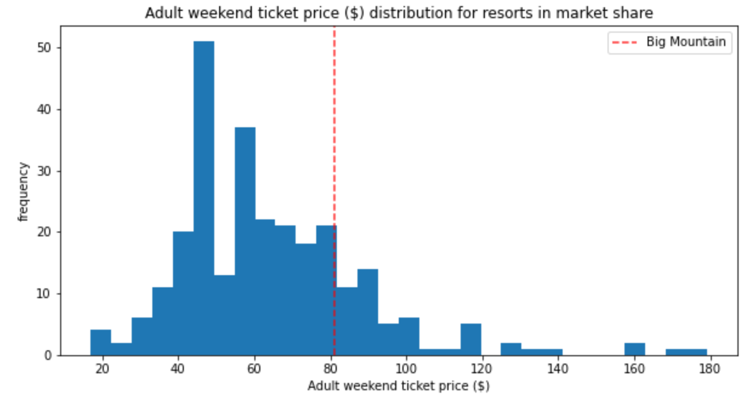
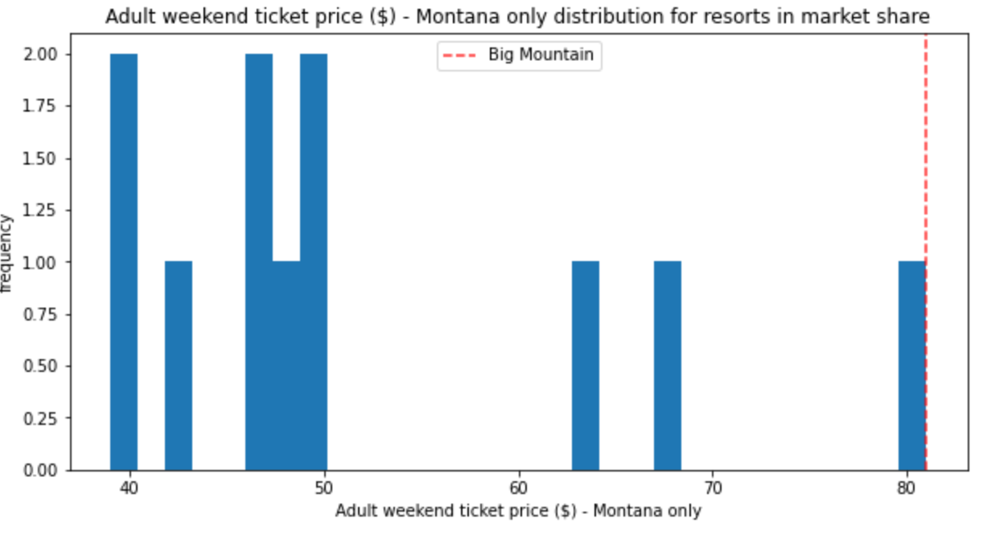
BMR current price is mid market.
But for resorts in Montana, they have the highest price.

Slide 6
Models Results & Analysis

Slide 7
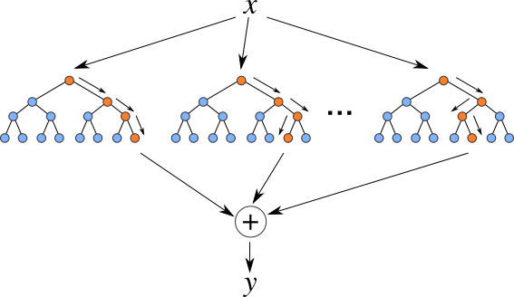
Random Forest Regressor
The random forest model had the lowest cross-validation mean absolute error and exhibited the least variability

Slide 8
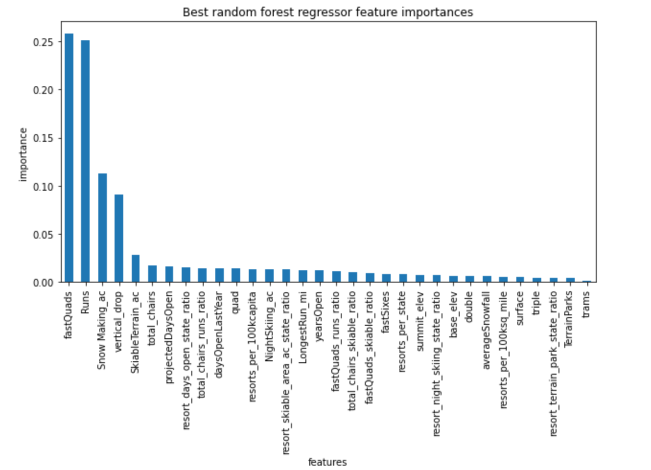
The dominant top four features are in common with your linear model:
fastQuads
Runs
Snow Making_ac
vertical_drop

Slide 9
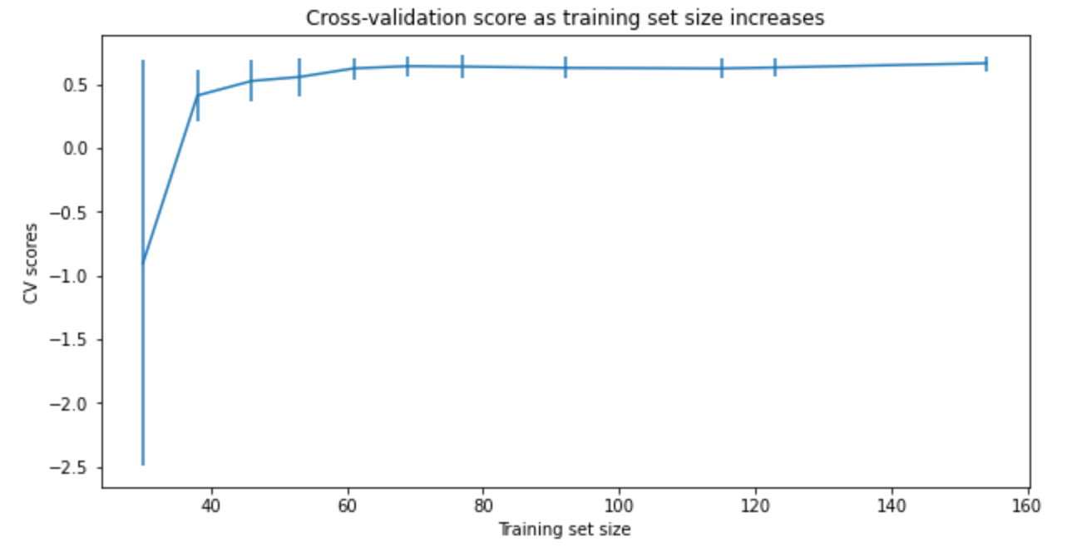
This shows that you seem to have plenty of data. There's an initial rapid improvement in model scores as one would expect, but it's essentially levelled off by around a sample size of 40-50.
Do We Need More Data

Slide 10
Summary & Conclusion

Slide 11
The model allows us to estimate ticket pricing depending on facilities BMR offer. Before increasing prices, we recommend comparing facilities for Montana resorts to determine: Whether the Montana market is capped Whether we have better facilities to justify a higher price.
It would also be worth adding operating costs to the data set to help determine the max return from each facility.

